Slide 1

Data-Driven Customer Classification for E-commerce Optimization By Kausik Chattapadhyay 04/28/2024

Slide 2

Business Problem
Understanding customer behavior is essential for optimizing marketing strategies and enhancing user experience in the dynamic e-commerce environment.
The project addresses the business problem by developing a data-driven classification system to categorize customers based on their purchase habits.
Analyzing an E-commerce database with records of purchases made by approximately 4000 customers over a year is central to this project's objectives.
The goal is to create targeted marketing strategies and personalized recommendations through insightful customer categorization.

Slide 3

Background/History
E-commerce platforms offer valuable insights from vast transactional data about customer preferences and trends.
Traditional marketing strategies often miss individual customer behavior nuances due to lack of granularity.
This project utilizes machine learning to categorize customers, empowering businesses to personalize offerings and promotions effectively.

Slide 4

Dataset
InvoiceNo: Invoice number.
StockCode: Product (item) code.
Description: Product (item) name.
Quantity: The quantities of each product (item) per transaction. Numeric.
InvoiceDate: Invoice Date and time. Numeric, the day and time when each transaction was generated.
UnitPrice: Unit price. Numeric, Product price per unit in sterling.
CustomerID: Customer number. Nominal, a 5-digit integral number uniquely assigned to each customer.
Country: Country name. Nominally, the name of the country where each customer lives.

Slide 5
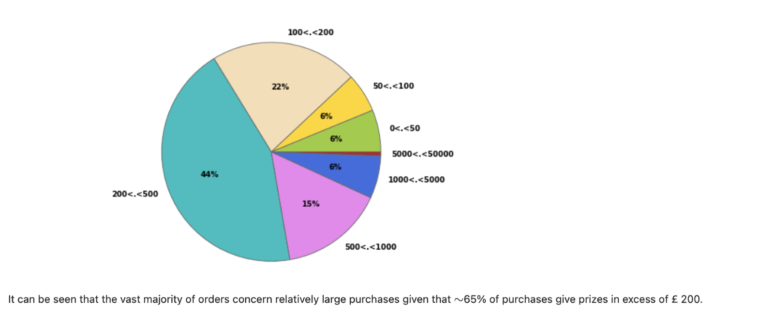
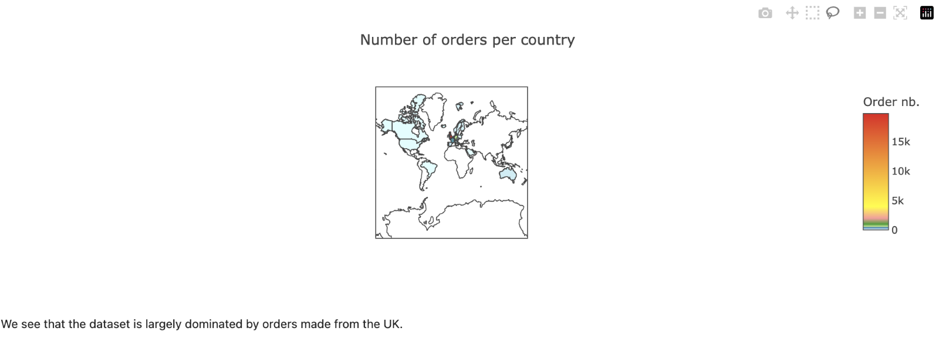
Data Explanation and Analysis

Slide 6
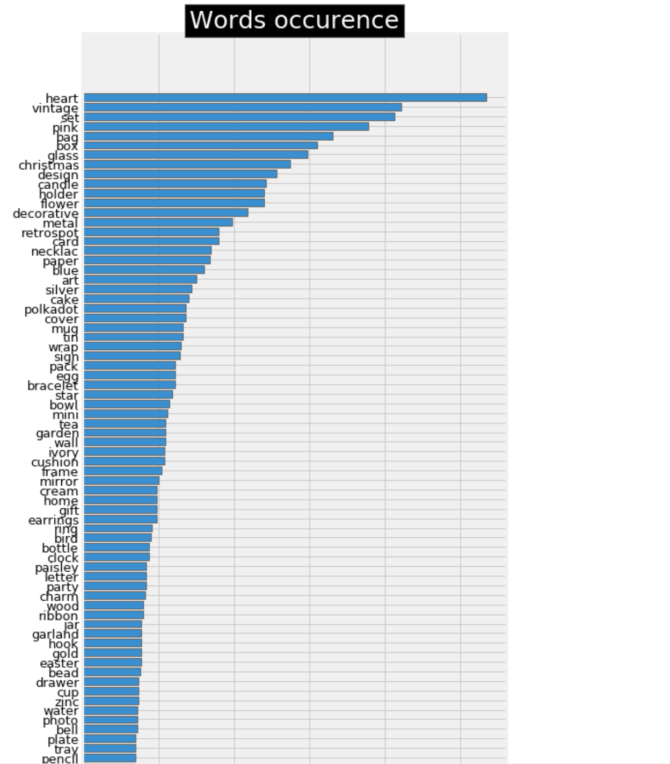
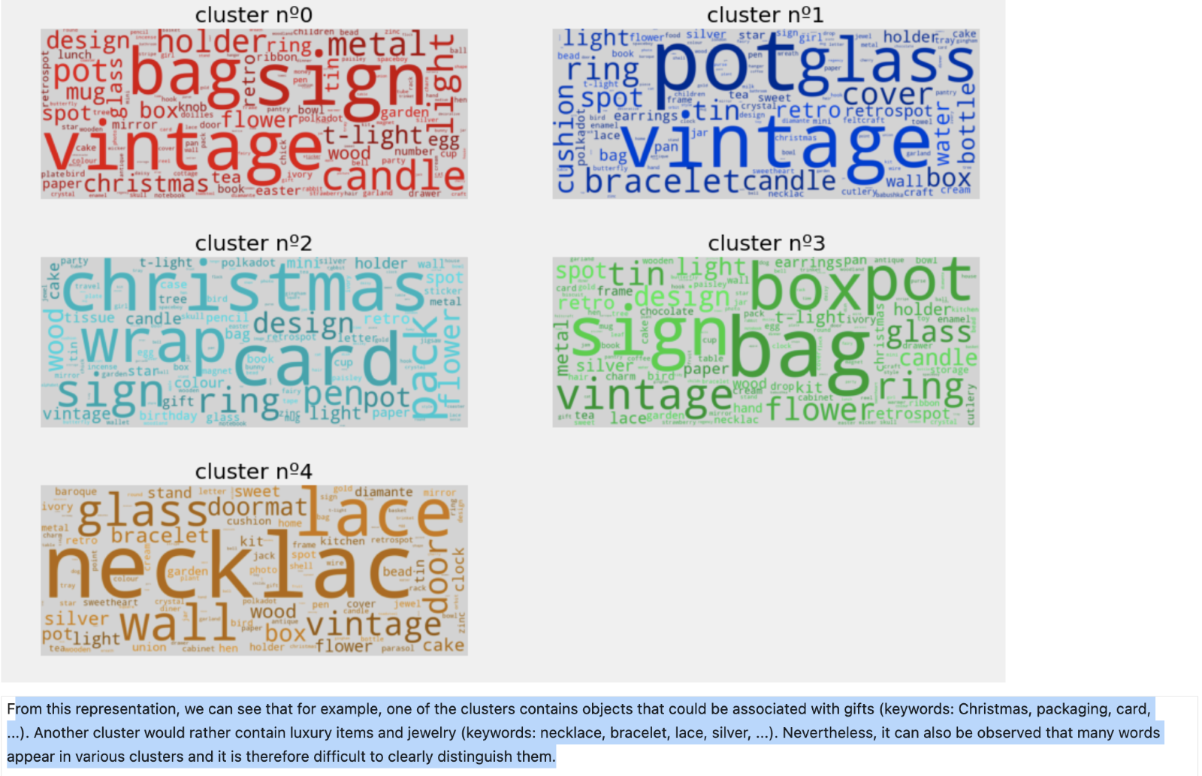
Data Explanation and Analysis

Slide 7
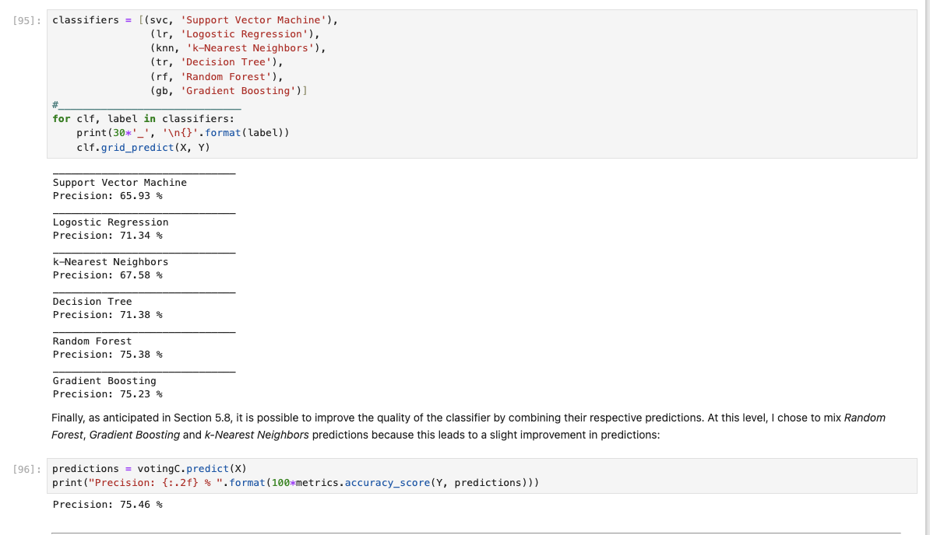
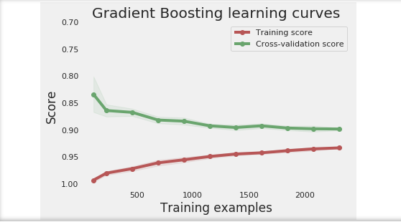
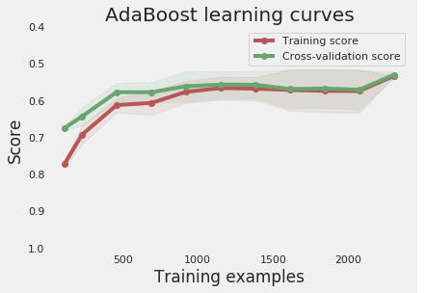
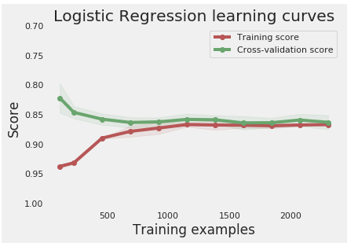
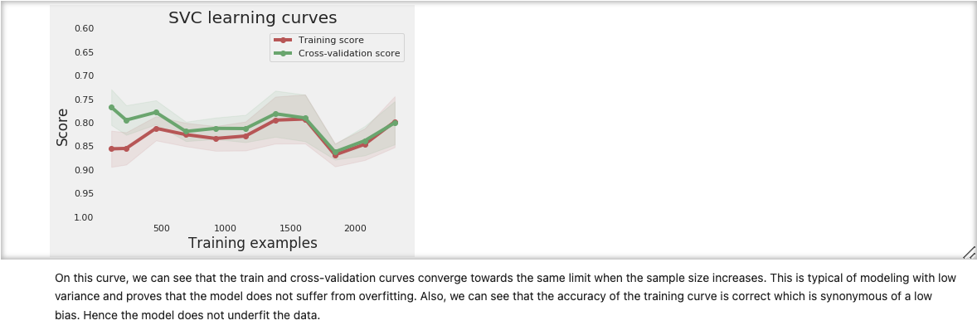
Method and Results

Slide 8
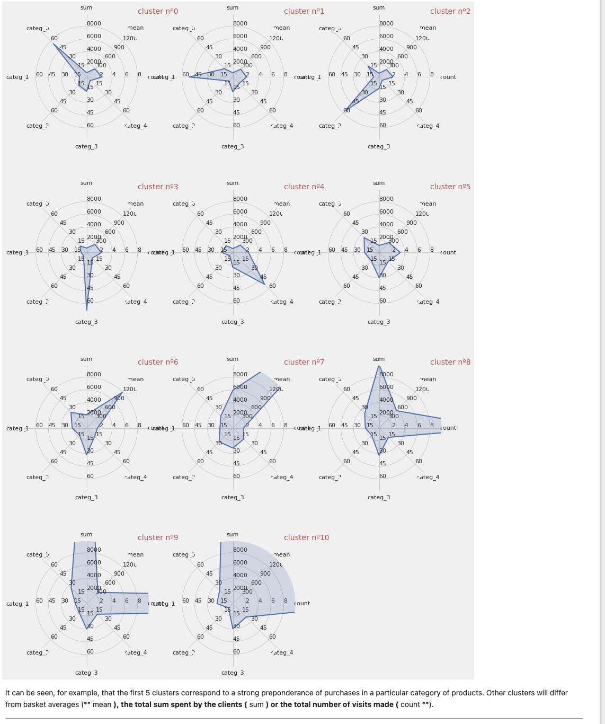
Methods and Results

Slide 9
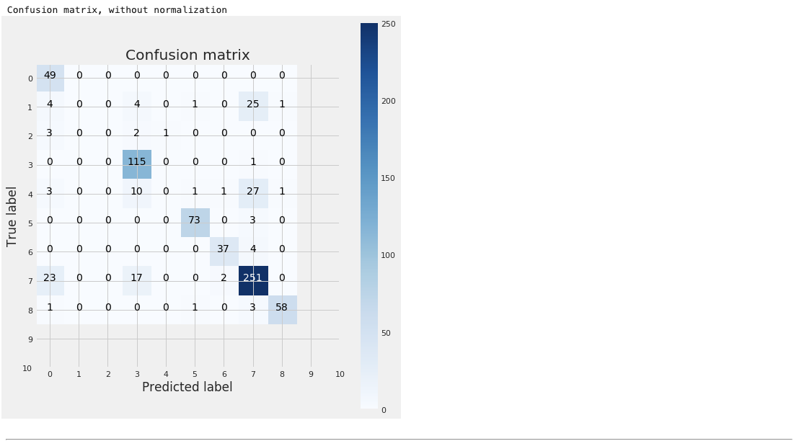
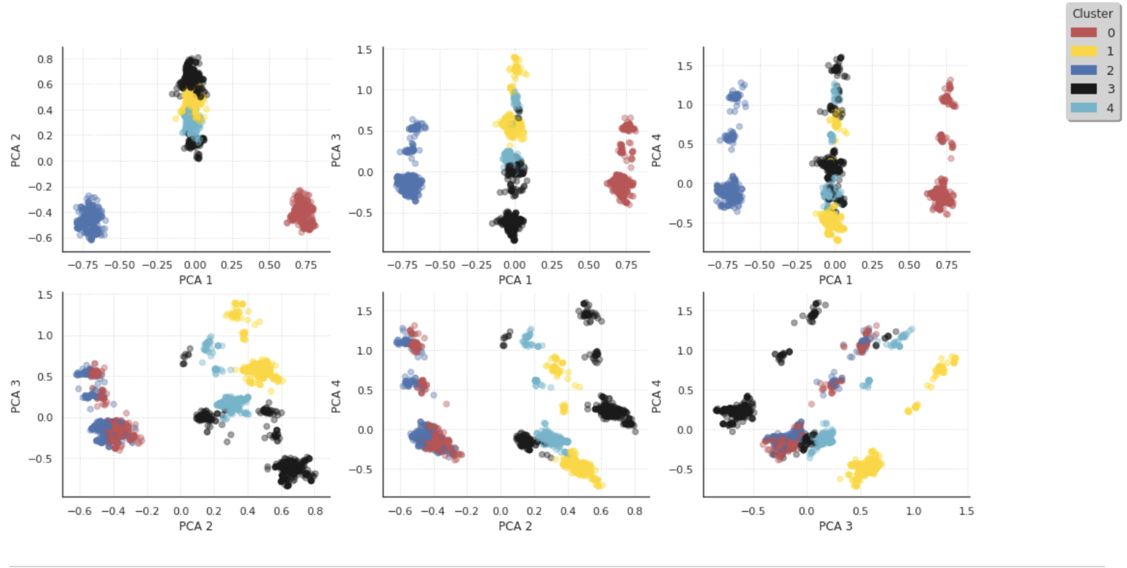
Methods & Results

Slide 10

Analysis
Evaluation metrics such as precision scores, learning curves, and confusion matrices were used to assess the performance of classifiers and ensemble methods
The analysis revealed promising results in accurately categorizing customers based on their purchase habits

Slide 11
Conclusion
Assumed that customer purchase behavior remains consistent over time
Assumed that the dataset is representative of the entire customer base

Slide 12

Limitations
Address seasonal variations in purchase behavior to enhance accuracy of long-term predictions.
Expand historical data collection to capture evolving customer behavior more accurately.
Handle imbalanced customer categories effectively within the model.
Ensure model generalization and mitigate biases through rigorous dataset evaluation and integration with real-time and external data sources.

Slide 13
Limitations
Utilize deep learning models to analyze intricate customer behaviors, employing sentiment analysis and image recognition for enhanced product recommendations.
Enhance model training and long-term predictions by gathering and integrating extensive historical data into the analysis.
Ensure model adaptability to changing customer behaviors and market trends through regular updates and retraining, maintaining relevance and accuracy over time.

Slide 14

Assumptions:
Assumed that customer purchase behavior remains consistent over time.
Assumed that the dataset is representative of the entire customer base.
Limitations:
Seasonal variations in purchase behavior were not fully accounted for, potentially impacting the accuracy of long-term predictions.
Limited historical data may restrict the model's ability to capture evolving customer behavior accurately.
Challenges:
Handling imbalanced classes in customer categories.
Ensuring model generalization to new customer data and unseen scenarios.
Addressing potential biases in the dataset, such as selection bias or data quality issues.

Slide 15

Implementation Plan
Seamlessly deploy the trained classification model to the e-commerce platform, prioritizing scalability and real-time performance.
Monitor and refine model performance metrics like accuracy and recall, iterating improvements based on data updates and feedback.
Collaborate with marketing teams to implement personalized campaigns and product recommendations driven by customer segments identified through the model.
Conduct regular evaluations and updates to maintain the model's effectiveness and alignment with evolving business goals.

Slide 16
Ethical Assessment
Data privacy, consent, and transparency were paramount, ensuring ethical usage of the model.
The white paper draft meticulously explores data preparation, methodology, and future recommendations.
Stakeholders gain a profound understanding of project objectives and strategic implications for business decisions.

Slide 17

References
https://www.kaggle.com/datasets/carrie1/ecommerce-data

